Slide 1

Retail Cluster Overview
July 2016
The information contained in the document is proprietary to Tata Industries Limited- Tata Insights & Quants Division and is strictly confidential. In consideration of receipt of this document, the recipient agrees that the information is being shared only for the limited purpose. The recipient of this information further agrees to maintain such information in confidence and to not reproduce, disclose, duplicate, electronically transmit or use in whole or in part for any other purpose. Prior written consent shall be obtained from the Insights & Quants Division of Tata Industries in case the information is necessitated to be shared with anyone other than the Recipient to whom this information is addressed. The above restriction shall not limit the right to use the information contained in this deck, if it is obtained from another source without restriction. © Copyright, Tata Insights & Quants Division, Tata Industries Limited

Slide 2
Retail Industry in India

Slide 3
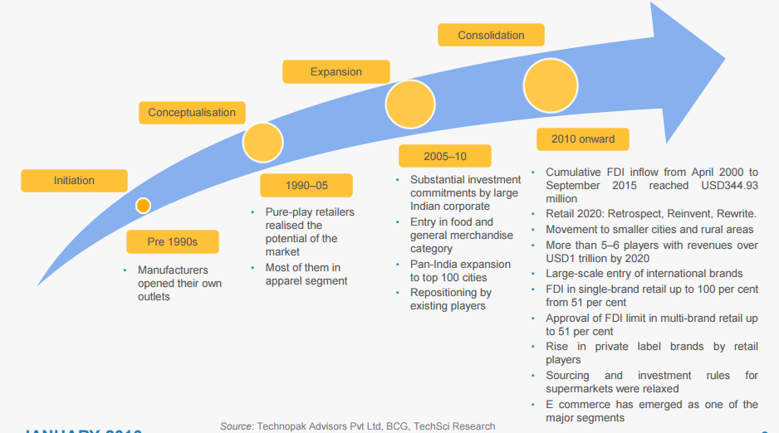
Evolution of Retail in India
Source: IBEF Retail Presentation Jan 2016, ibef.org

Slide 4
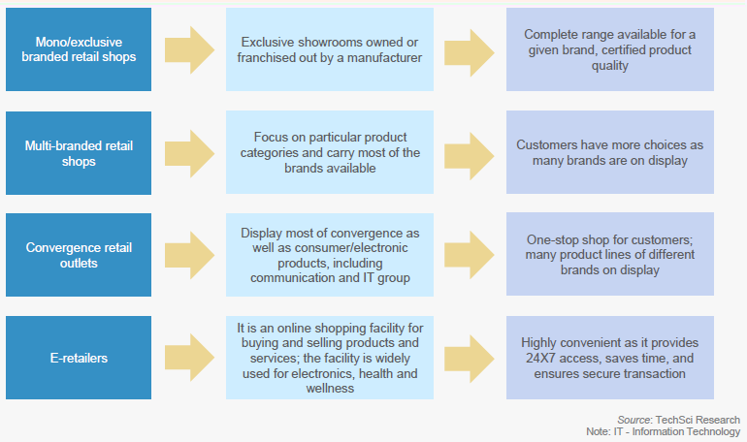
Retail Formats in India
Source: IBEF Retail Presentation Jan 2016, ibef.org

Slide 5
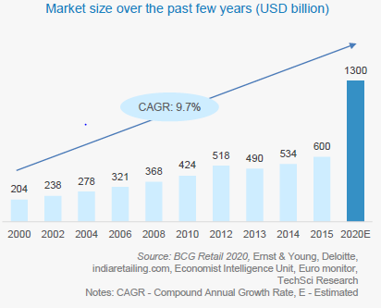
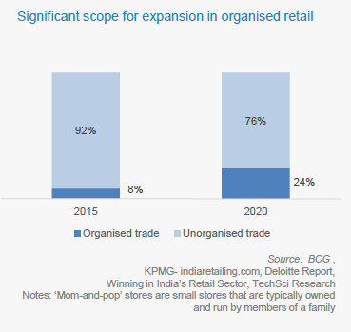
Retail Formats in India
The retail sector in India grew 7.5% CAGR from 2000 to 2015
However, the organized sector forms just 8% of the Total Retail Industry in India today
Source: IBEF Retail Presentation Jan 2016, ibef.org

Slide 6
Tata Group Retail Presence

Slide 7
Retail and Consumer Products Companies
Company | Business | Key Brands
Casa Décor | JV between the Tata group and Poltrona Frau Group (Italy), a leader in luxury furnishings. | Casa Décor
Infiniti Retail | Consumer Electronics Retail | Croma
Tata UniStore | ecommerce marketplace. India's latest destination for authentic and exclusive brands | Tata Cliq
Titan Company | A manufacturing company that produces India's largest and best-known range of personal accessories— watches, jewellery, sunglasses and prescription eyewear. | Titan, Tanishq, Eye+
Trent | Apparel retail, hypermarkets and family entertainment stores | Westside, Star Bazzar, Landmark

Slide 8











Croma Competitive Set
The Competitive Set can be categorized by business model. The focus has been placed on brands which have physical stores, with or without an e-commerce channel
Stores Only
Omni Channel
Purely E-commerce
Traditional brick & mortar without e-commerce | Brick & mortar but with e-commerce capabilities | Purely e-commerce, no physical stores
Website primarily used to showcase collections & product ranges | Website used to showcase collections, but with the option of buying online | Website entirely geared towards driving purchases online
Viveks has a small share of traffic, and hence not benchmarked against |  | This set has not been considered in the analysis
Focus has been placed on competitors of Croma with a physical store presence
General shopping sites such as Amazon, Flipkart or Snapdeal with a significant consumer electronics segment have not been considered for this analysis
© Copyright, Tata Insights & Quants Division, Tata Industries Limited

Slide 9













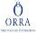




Tanishq Competitive Set Considered
The Competitive Set can be categorized by business model. The focus has been placed on brands which have physical stores, with or without an e-commerce channel
Physical Stores
Omni-Channel
E-commerce(Jewelry)
E-commerce
Traditional physical stores, without e-commerce | Traditional physical stores, with e-commerce | E-commerce focused on Jewelry | Purely e-commerce including Jewelry
Website primarily used to showcase offerings without an ecommerce channel | Website showcases offerings, and allows online purchases | Website is the only channel for purchases | Website is the only channel for purchases
Joyalukkas has a link to buy online from Amazon. PCJ from WearYourShine. | Considered here if sales allowed though a sister website (e.g. Tanishq-Titan) | Players focused on Fashion / Imitation Jewelry not considered | This set has not been considered in the analysis
Focus has been placed on Tanishq with a physical store presence
© Copyright, Tata Insights & Quants Division, Tata Industries Limited

Slide 10







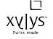






Titan (Watches) Competitive Set
Titan has a strong presence in India in the Watches market. This study will take a glimpse into Titan’s major watch brands. We also peek at how Global watch brands are faring online
Indian Watch Brands
Indian Watch Stores
Global Watch Brands
Brands with an India only website | Branded Retail Outlets, focused on watches | Available in India, but without an India specific website
Four Titan owned brands and one competition brand with an India specific website considered | Retail stores not focused exclusively on watches have not been considered | Websites of five global watch brands considered based on web visits
© Copyright, Tata Insights & Quants Division, Tata Industries Limited

Slide 11










Titan Eye+ Competitive Set
The Competitive Set can be categorized by business model. The focus has been placed on brands which have physical stores, with or without an e-commerce channel
With Physical Stores
E-commerce Eyewear
General E-commerce
Traditional physical stores, without e-commerce | Purely e-commerce focused on eyewear | E-commerce including Eyewear
Website primarily used to showcase offerings without an ecommerce channel | Website is the only channel for purchases | Website is the only channel for purchases
 | Lenskart has a few physical stores, but online remains its primary channel, and hence its categorization here | This set has not been considered in the analysis
Focus has been placed on Titan eye + with a physical store presence
© Copyright, Tata Insights & Quants Division, Tata Industries Limited

Slide 12




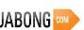







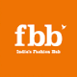


Westside Competitive Set
The Competitive Set can be categorized by business model. The focus has been placed on brands which have physical stores, with or without an e-commerce channel
Stores Only
Omni Channel
Apparel E-commerce
General E-commerce
Traditional physical stores, without e-commerce | Physical stores, but with e-commerce capabilities | Purely e-commerce focused on apparel | Purely e-commerce, including apparel
Website primarily used to showcase offerings | Website provides an additional channel for purchases | Website is the only channel for purchases | Website is the only channel for purchases
Central Mall has no website, hence excluded | M&S India has no e-commerce on its site, hence excluded | Abof.com considered since Jun ‘15 after website launch | This set has not been considered in the analysis
© Copyright, Tata Insights & Quants Division, Tata Industries Limited

Slide 13
Retail Analytics Landscape

Slide 14
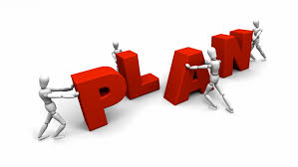


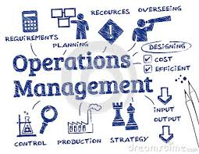
Retail Analytics Landscape
Planning
Marketing
Operations
Digital
Assortment optimization & shelf space planning
Integrated forecasting
Localization & store clustering
Price Optimization
Real estate optimization
Marketing mix models
Segmentation
Customer behaviour analytics
Loyalty analytics
Product recommendations
Campaign analytics
Supply chain analytics
Workforce analytics
Store level decision management
Analytical performance management
Fraud analytics
Social media analysis – engagement, topics, sentiment, perception
Web analytics
Omni channel analytics
Data Integration & Data Engineering
Data Science
Test & Learn
Implement & Track
Confidential Property of Tata Industries Ltd – Tata Insights & Quants Division

Slide 15
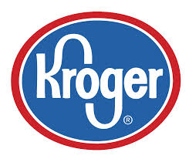
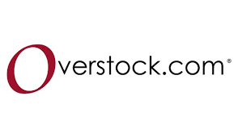





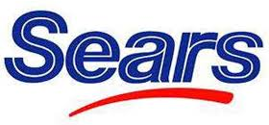

A few global success stories
- $2.5 million in labour efficiencies and $1.5 million in operating improvements through assortment optimization
mailings show a significant increase in redemption rate– power of customer & campaign analytics
targeted and event-driven email marketing to customize offer & price – 50% revenue lift from email channel
A few examples of successful adoption of analytics beyond the more popular examples:
Tesco ClubCard
Amazon’s recommender system
BestBuy store customization
forecasts linked to assortments, allocations, and pricing optimization systems. Improvement in inventory turnover by 10%
store clustering based on shopper characteristics, geo data, etc. – localized assortment, planning localized pricing
major localization initiative called “My Macy’s”
MMX exercise: resulted in less spending on print, and more on ot
7% more profit due to an optimal market mix (print media prioritized over TV)
higher margin through price optimization
store-level sales and demand forecasting - 40% reduction in order changes
Confidential Property of Tata Industries Ltd – Tata Insights & Quants Division

Slide 16
Store Optimization
Framework

Slide 17






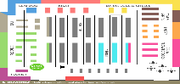






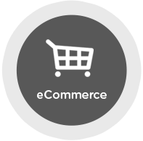
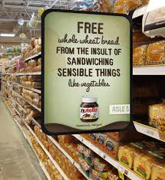


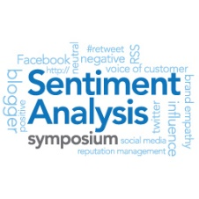

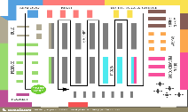




Store Optimization Framework
A store optimization framework needs to take into consideration multiple external and internal drivers
Geo Potential Index
Store Quality Index
Store Performance
Revenue
Fixed Cost
Variable Cost
Profitability
----------------------------------
New Stores
Existing Stores
Affluence
Growth
Demographics
Inventory
Area/Layout
Traffic
eShopping
Penetration
Real
Estate
Better ROI
Reduction in Breakeven Time
Store Benchmarking
Sales Force
Store Format
In-store activity
Competition Store Index
Customer Loyalty Index
Promotions
In –store display
Location
Area/
Layout
Brand
Sentiment
Incentives
Repeat
Purchase
Basket
Size
Loyal
Customers
External Factors
Internal Factors
Confidential Property of Tata Industries Ltd – Tata Insights & Quants Division

Slide 18



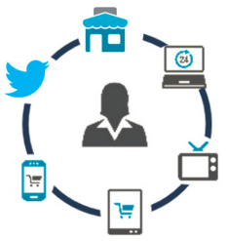



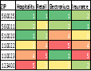
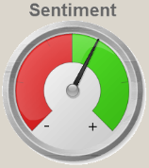



The Journey from Data to Business Results
A store optimizer needs to leverage multiple data elements to make meaningful decisions
Data Input
Analytics
Results & Impact
External
Aggregated external
data for micro-geography
Aggregate data from Tata Companies
Traffic and map data
Competition location data
Social media & blogs
Sophisticated Solutions
Catchment area identification
Geo profiling and geo clustering for catchment area attractiveness
Retail gravity modeling for assessing probability of visit
Traffic and map analysis for location planning
Video data analysis and emotion mining
Action-effect modeling for understanding impact of promotions & displays – attribution modeling
Sales force effectiveness analysis
Inter purchase time modeling
Basket size analysis
Financial modeling
Results
Attractiveness of store location
Potential of a particular store
Driver of revenue and cost
Expected revenue and cost
Pro-forma P&L and ROI
Actual vs. expected tracking
Internal
Customer, transaction
and loyalty data
In-store video data for
customer satisfaction
& interaction
Sales force information
Promotion and in-store display ads
Impact
Potential of a store
Comparison of potential and
actual performance
Expected revenue and margin
Identify new store location
Ascertain if any existing store
should be closed down
Confidential Property of Tata Industries Ltd – Tata Insights & Quants Division

Slide 19
Results of the Store Location Planning POC
Initial POC
TTSL
Croma
Tata Capital
Tata Motors
Location planning for Croma for a metro center leveraging Croma internal data and Tata iQ proprietary data
Used a retail gravity model and Google drive time
Identification of locations for 4G towers
Uses Google traffic density data as well as other data elements
Assortment planning for compromised stores
Uses a “similar store” identification methodology using aggregated geo data
Internal data for validation
Planning optimal DSA strategy
Compares location attractiveness with DSA effectiveness to spot locations that need new DSA or changes in existing DSA
Compare location attractiveness with market share
Location for “new-age”dealers
Confidential Property of Tata Industries Ltd – Tata Insights & Quants Division

Slide 20
Current Ongoing
Engagement (Croma)

Slide 21










Engaging with Croma for better business decisions with Analytics
Store Analytics
Pricing &
Promotions
Analytics
Customer Analytics
Merchandising Analytics
Campaigns
Analytics
Leverage internal store data and External location & establishment characteristics to identify the right location
Analysing consumer reactions to pricing and promotion, to optimize pricing and promotional mix
Suggest the optimal mix of assortment to offer customers at each store
Understand Customer Profiles & Behaviours to
recommend actions to be more relevant
Location Planning for Hyderabad
Store Launch Ready Reckoner (in progress)
Price Optimization Exercise
(in progress)
Measuring Campaigns in a scientific way to ensure effective campaigns
Purchase Propensity models recommended targets for campaigns
Area Compromized Store Assortment
(in progress)
Universal Control Group in place

Slide 22





Engagement Roadmap
Apr – Mid Jun
Mid Jun - Aug
Sep - Dec
Beyond Dec
Transitions
Transitions completed
Integrated 9 data sources (4 incremental)
Upgraded new customer logic
Redefined campaign dormancy
Contact data mart
Data enrichment
Tableau dashboard – current reports
Automation of all data processes
Tableau dashboard new reports (e.g. store ready reckoner)
Online-offline integration
Building the Foundation
Purchase Models for 2 product categories
Compromised area store assortment optimizer
Comprehensive segmentation (customer and store)
Pricing optimization for one category
Store ready reckoner
Funnel analysis for all campaigns across last 12 months
Deal seeker model
Response models for 2 categories
Campaign Strategy
Comprehensive price optimization (all categories)
Response models for 2 additional categories
Tracking of all models and segmentation (ongoing)
Product & Offer Recommendations (Next best Offer)
Supply Chain Analytics
Workforce Analytics
Digital Analytics
Creating Value
NPS execution
Lead generation from enquiries
Initiated new creative development
Refreshing CLC campaigns
Additional CLC Campaigns
Referral programs
Whatsapp as a channel
Test effectiveness of time of day/week
To be Planned
Forecasting and what-if scenarios
Delivering Value
Measuring Value
Measured based on historical benchmarks
Universal control group
Project wise value tracking
Long Term Campaign Effectiveness
Creative effectiveness
Comprehensive Value Tracking
Confidential Property of Tata Industries Ltd – Tata Insights & Quants Division

Slide 23




Building Foundation: Capabilities Built for E2E Campaign Management
Creative Design
Contact Summary
HTML and Hosting
Campaign Delivery
Design sketch or wire frame options shared for a new design approach. adapting existing Creatives for appropriate messaging and maintaining brand equity
Creating Targeting File, and counts by different contact groups, with optimised reach to customers
HTML creation, testing and execution. One Stop Shop set up for Campaign Design, Targeting, and Execution
Day-Slot wise Campaign Delivery process set up for operational efficiency and time-relevant communications

Slide 24
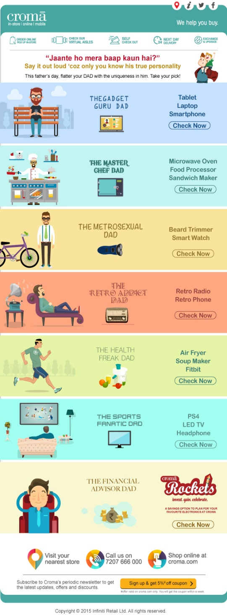

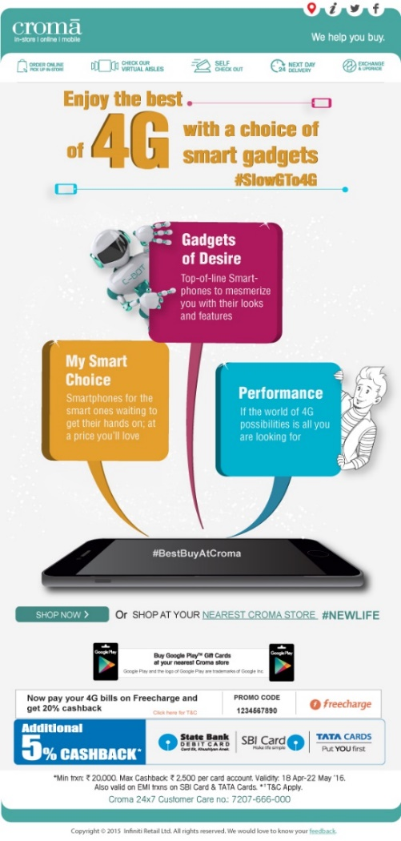
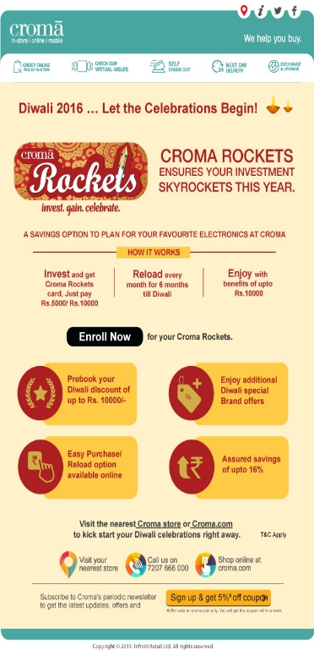
Building Foundation: A Few Campaign Creatives
Relevant Creatives for Events
Product based Campaign Creatives
Engaging customers in festivities
Special Occasions – connecting with customers
Notes:
Rabindranath 4.3%, 0%
4g 8-10%,
Rockets A&B 7%, 0.1%
Rockets Round 3 12% 0.11%
Father’s Day 10.5% 0.06%

Slide 25
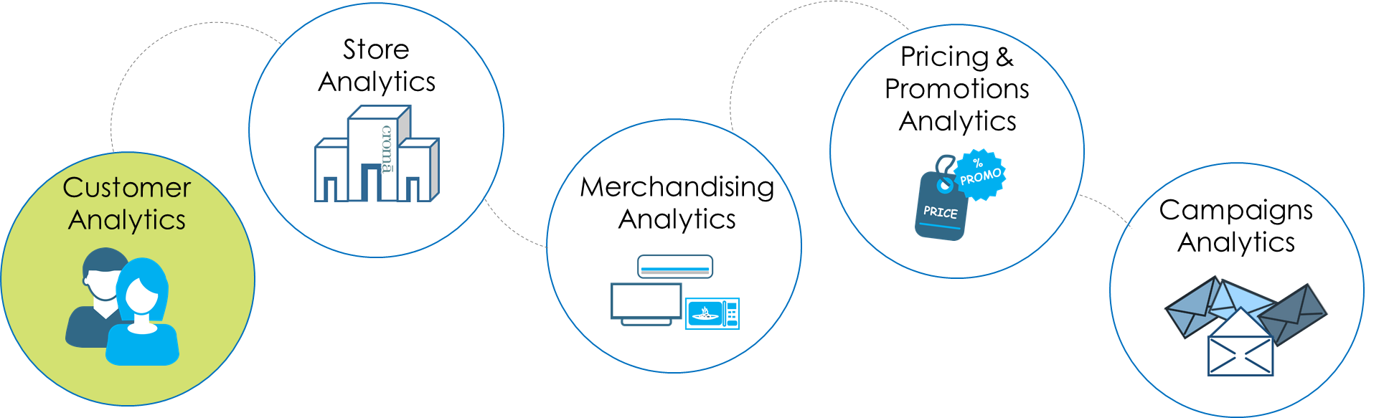






Creating Value: Model driven Campaigns
Business Objective
Methodology
Business Value
Effective Targeting through Relevance
Propensity to buy Mobile
Propensity to buy Laptops
Incremental Revenue per Mailer
Open Rates
Response Rates
Predictive Model for propensity to shop
Predictive Model for propensity to open
(Next model onwards)
Increase by
71%
Increase by
66%
Up to
67%
Increase effectiveness of Direct Marketing
TiQ delivered model based targeting for 2 campaigns –mobiles and laptops.
Modelled approach demonstrated incremental benefit over rule based targeting
Mobile : Open Rates 9.3% Vs. 5.4% | Response Rate of 0.13% Vs. 0.08%
Laptop : Revenue per Mailer 17.2 Vs. 10.3
Notes:
4G: 1.5 Cr Vs. 1 Cr. But per email 14.01 Vs. 21.7
Laptop: 86 Lacs Vs. 84 Lacs. But per email 10.3 Vs. 17.2

Slide 26
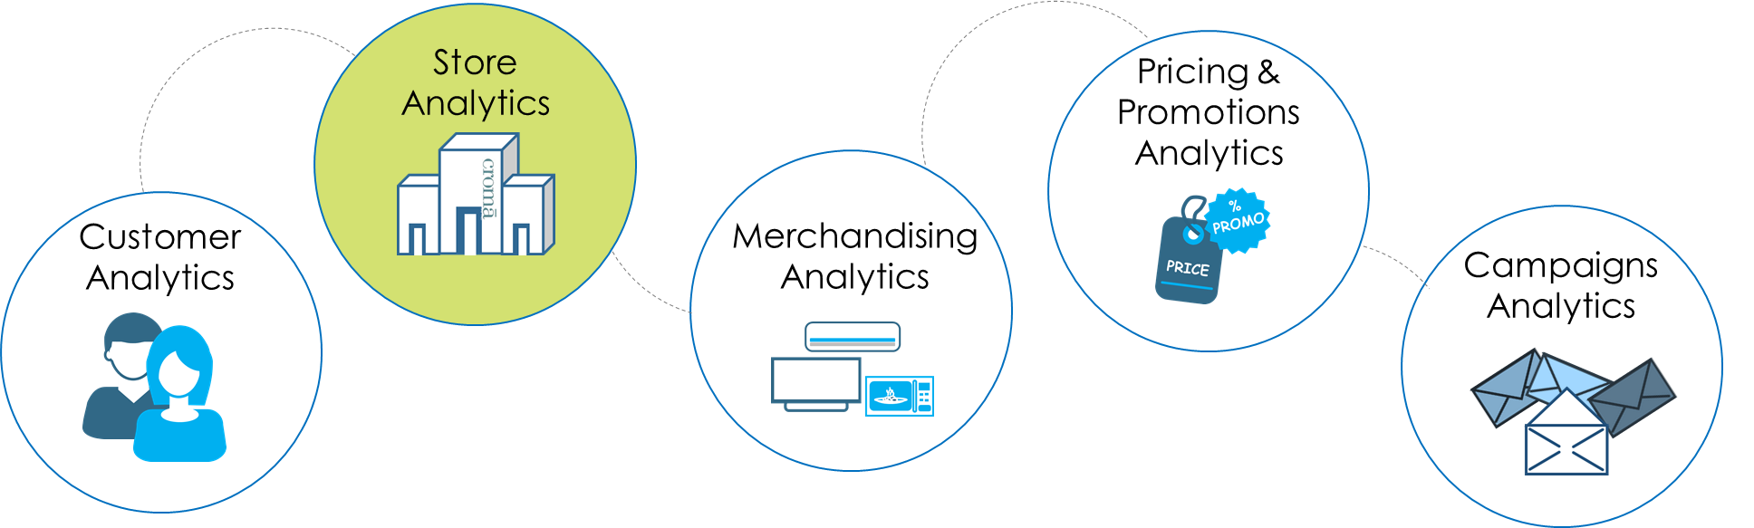


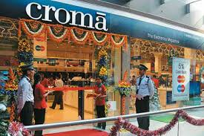



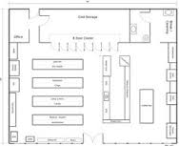
Creating Value: Store Launch Ready Reckoner
Business Objective
Methodology
Business Value
How do different characteristics affect store launch performance?
Planning for New Store Launches by analysing store launch patterns and performances with respect to time, store-size, competition intensity, assortment and location
Predict & Prescribe
Launch Success
Drivers of Success
Store Success Measure
Identifying Steady State
Create Visualization dashboard and Store Performance Predictor to estimate performance post-launch
Identify Drivers of Store Success post-launch using regression models
Which characteristics drive launch performance?
Store KPI Trend Charts since inception through TS Decomposition to define Steady State
Using a regression 2-stage model framework, create a consolidated measure of success for every store

Slide 27
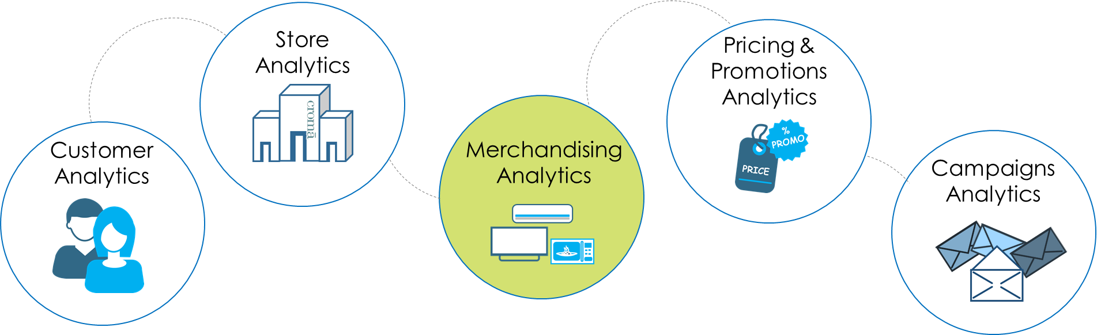
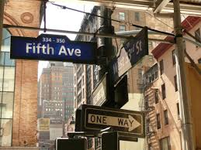
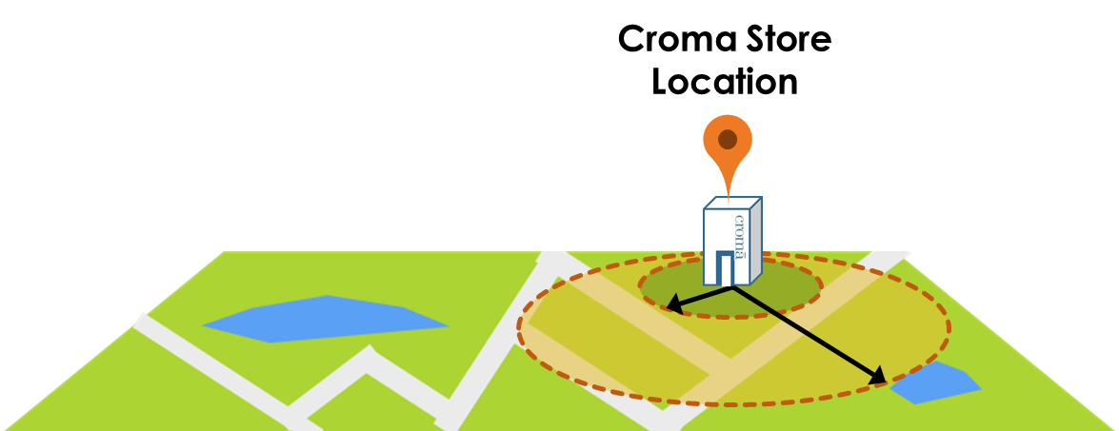

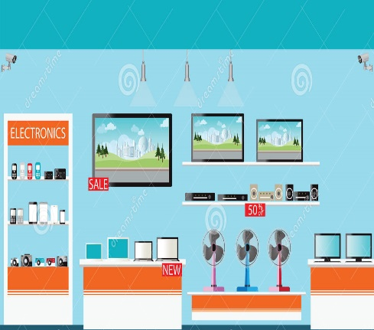
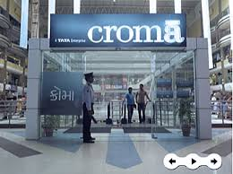
Creating Value: Store assortment optimizer
Business Objective
Methodology
Business Value
Key Locational Metrics
Maximize Revenue
Min. Threshold Affordability
Home and Auto purchases
Affluence
Age Demographics
Many locations don’t allow the luxury of “space”
Pin 1
Pin 2
Model Stores based on Geo Location and Assortment
Classify Compromised Stores
Compare Assortment
Recommend assortment changes
By ensuring each store has the ideal mix of categories
What is the ideal assortment in limited space?

Slide 28
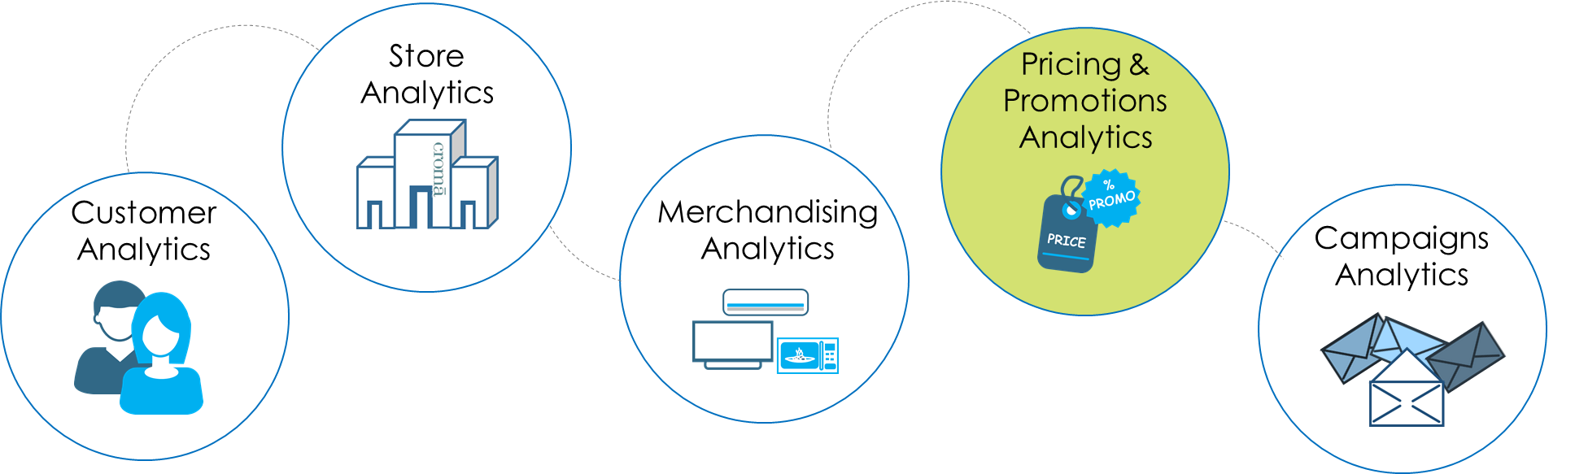
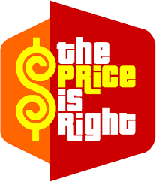


Creating Value: Price Optimization Pilot
Business Objective
Methodology
Business Value
Create SKU clusters
Maximize Revenue
What’s the “right” price?
Optimize Revenues based on prices
Build price elasticity models
Run global optimization – at category level
Run local optimization – at SKU level
By suggesting the “right” price
Confidential Property of Tata Industries Ltd – Tata Insights & Quants Division

Slide 29
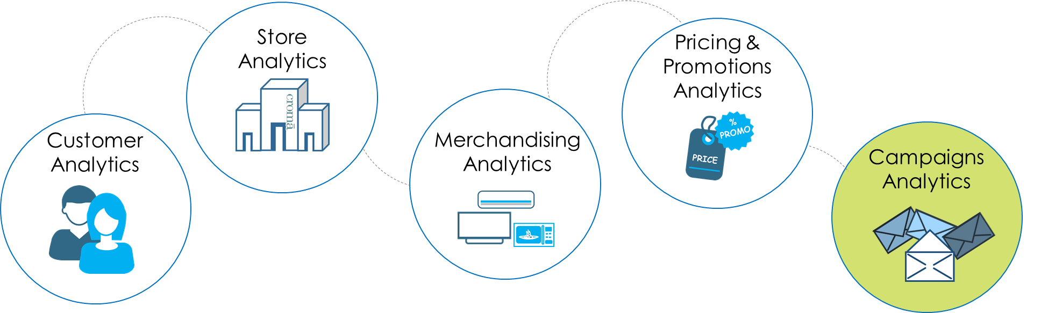

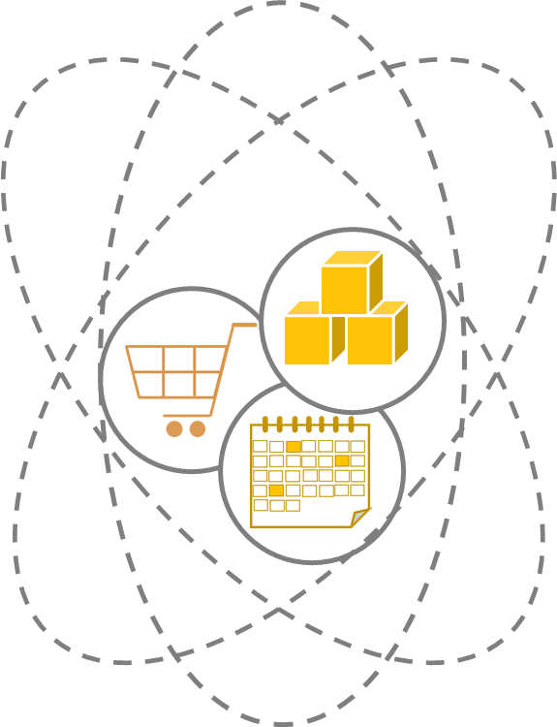



Delivering Value: Lead Generation from Product Enquiries
Customer makes Product Enquiries to Croma Call Centre
Select the most optimal communication (offer) to be sent to Customer
Customer is sent a relevant offer on shopping in the store, or for category or product group enquired
Offers!
A Test and Control is currently underway for measuring the effectiveness of a category offer Vs. whole house offer Vs. no offer

Slide 30



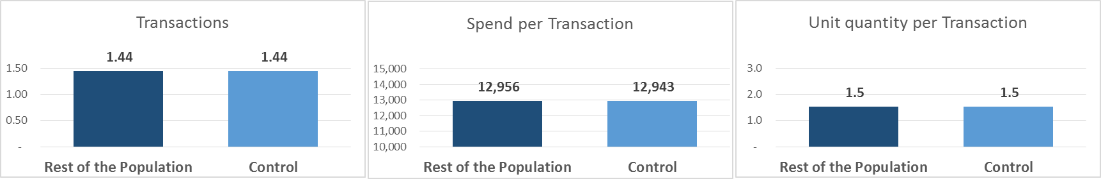
Measuring Value: Universal Hold Out Control
Longer term value campaigns generate
Does it trigger customer transactions and sales?
Laying the Foundation towards this Measurement
Measure behaviour over a quarter to six months
Rest of the base
Universal Hold-Out Control
Analyze buying behaviour of customers with respect to control
5% of Total Base
Representative sample of 5% of the population who would not receive any promotional communication
?
Measure and track long term campaign effectiveness
Confidential Property of Tata Industries Ltd – Tata Insights & Quants Division

Slide 31
Thank You

